Slide 1
Electronics Components and Circuits
Chris Marone & Clay Wood
Techniques of Geophysical Experimentation
3 Feb 2021
and contributions by John Leeman

Slide 2
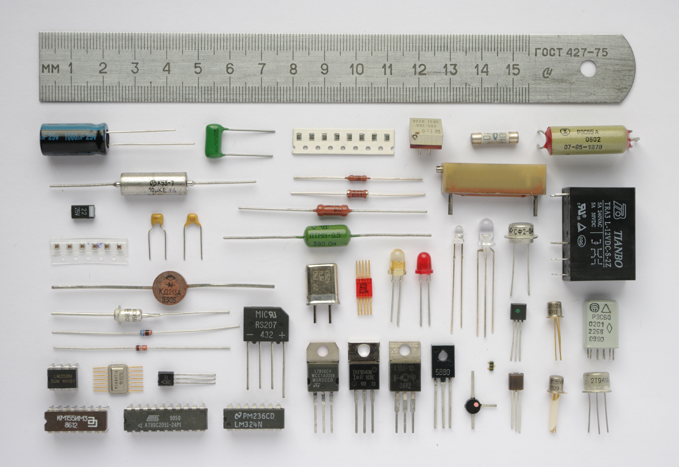
Some fundamentals of electronics starting from components, schematics, and basic circuit analysis
Image: Wikipedia
Notes:
Theory is when you know everything, but nothing works. Practice is when everything works, but no one knows why. In our lab, theory and practice are combined: nothing works and no one knows why.

Slide 3
Electric circuits are closed loops that electrons flow through. Electrical energy is the stored electrical potential difference
current flow & electron flow
Image: Sparkfun
Notes:
Theory is when you know everything, but nothing works. Practice is when everything works, but no one knows why. In our lab, theory and practice are combined: nothing works and no one knows why.

Slide 4
Here’s a basic circuit. Think about voltage, current, resistance and their relation
Image: Wikipedia
Notes:
Theory is when you know everything, but nothing works. Practice is when everything works, but no one knows why. In our lab, theory and practice are combined: nothing works and no one knows why.

Slide 5
A water system is used as a common analogy
Image: Hyperphysics
Notes:
Theory is when you know everything, but nothing works. Practice is when everything works, but no one knows why. In our lab, theory and practice are combined: nothing works and no one knows why.

Slide 6
Voltage is similar to water pressure in a hydraulic system
Image: Sparkfun
Notes:
Theory is when you know everything, but nothing works. Practice is when everything works, but no one knows why. In our lab, theory and practice are combined: nothing works and no one knows why.

Slide 7
Current is analogous to water flow
Image: Sparkfun
Notes:
Theory is when you know everything, but nothing works. Practice is when everything works, but no one knows why. In our lab, theory and practice are combined: nothing works and no one knows why.

Slide 8
Resistance is similar to flow limits due to the water pipe size
Image: Sparkfun
Notes:
Theory is when you know everything, but nothing works. Practice is when everything works, but no one knows why. In our lab, theory and practice are combined: nothing works and no one knows why.

Slide 9
Voltage, Current, and Resistance are all related
Image: Sparkfun
Notes:
Theory is when you know everything, but nothing works. Practice is when everything works, but no one knows why. In our lab, theory and practice are combined: nothing works and no one knows why.

Slide 10
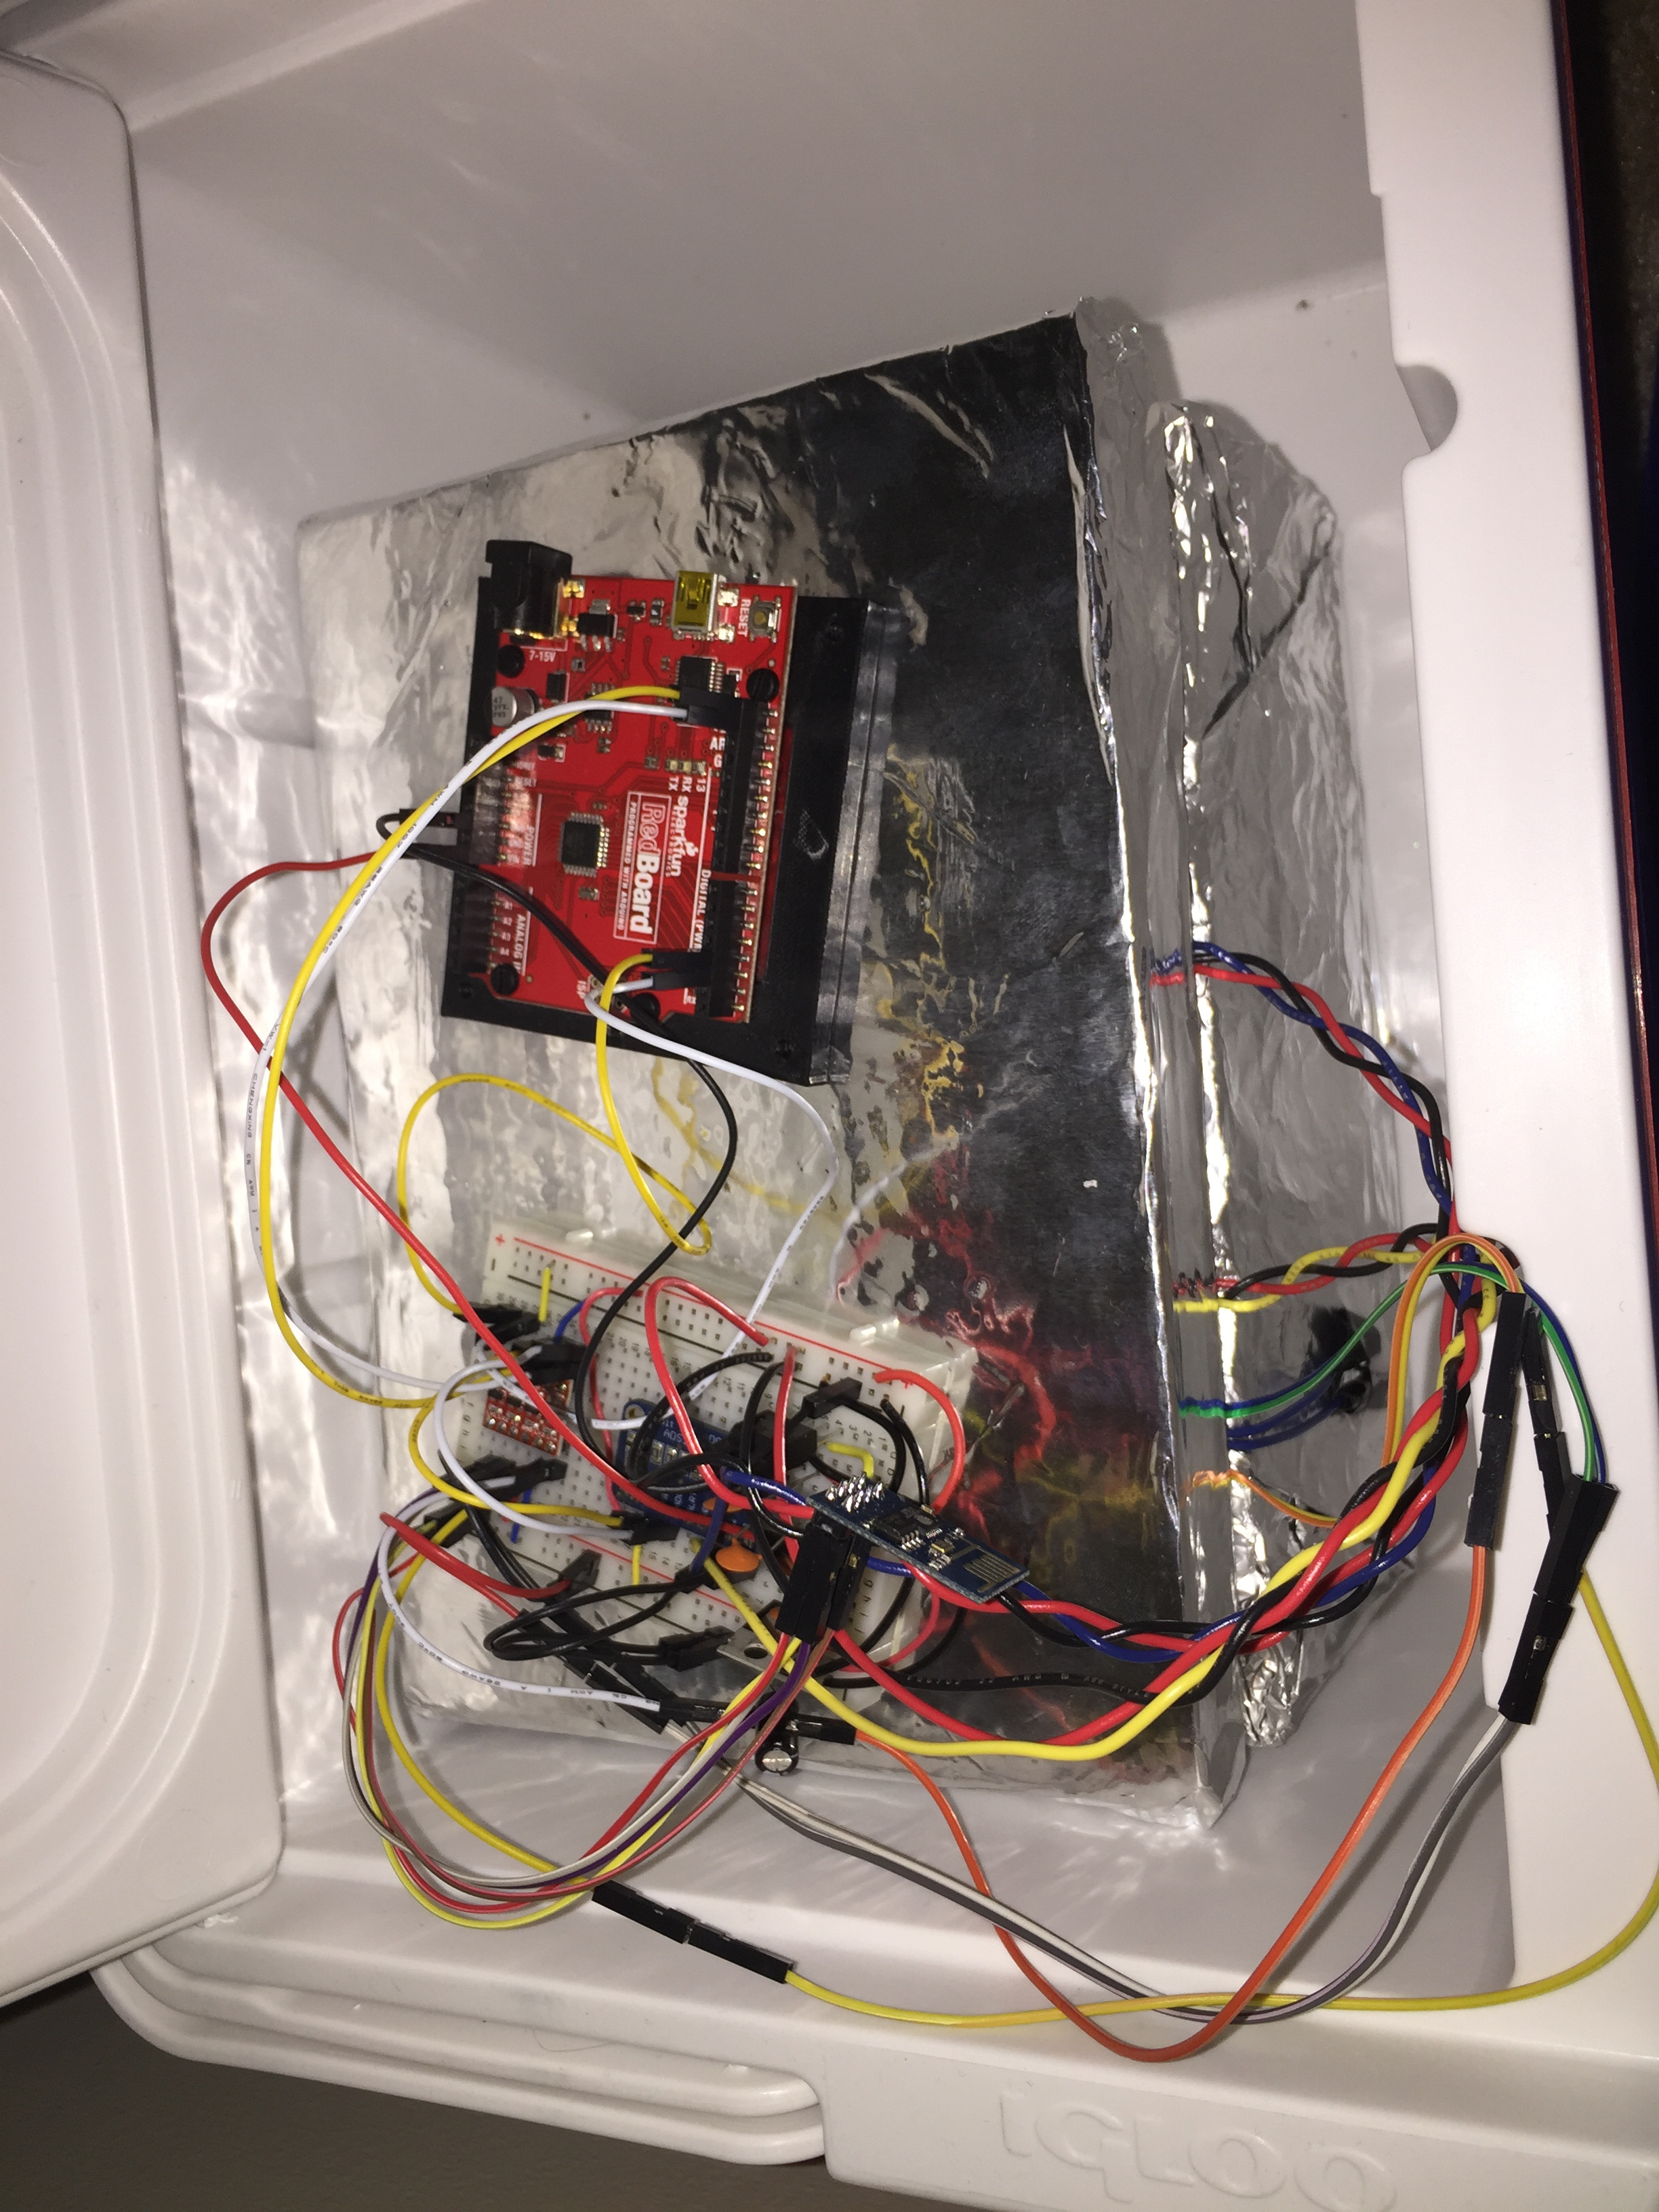
When building and prototyping electronics we need different levels of permanence
Finished/Production
Permanent
Image: cormsquare.com
Image: physics.mcmaster.ca
Image: J.R. Leeman
Temporary
Notes:
Theory is when you know everything, but nothing works. Practice is when everything works, but no one knows why. In our lab, theory and practice are combined: nothing works and no one knows why.

Slide 11
Breadboards offer quick prototyping and let you reuse components
Image: elasticsheep.com
Notes:
Theory is when you know everything, but nothing works. Practice is when everything works, but no one knows why. In our lab, theory and practice are combined: nothing works and no one knows why.

Slide 12
They have columns of interconnected spring clips internally
Image: electronics-sarath.blogspot.com
Image: sciencebuddies.org
Notes:
Theory is when you know everything, but nothing works. Practice is when everything works, but no one knows why. In our lab, theory and practice are combined: nothing works and no one knows why.

Slide 13
Cut off or clean the glued ends of components
Image: prismglow.com
Notes:
Theory is when you know everything, but nothing works. Practice is when everything works, but no one knows why. In our lab, theory and practice are combined: nothing works and no one knows why.

Slide 14
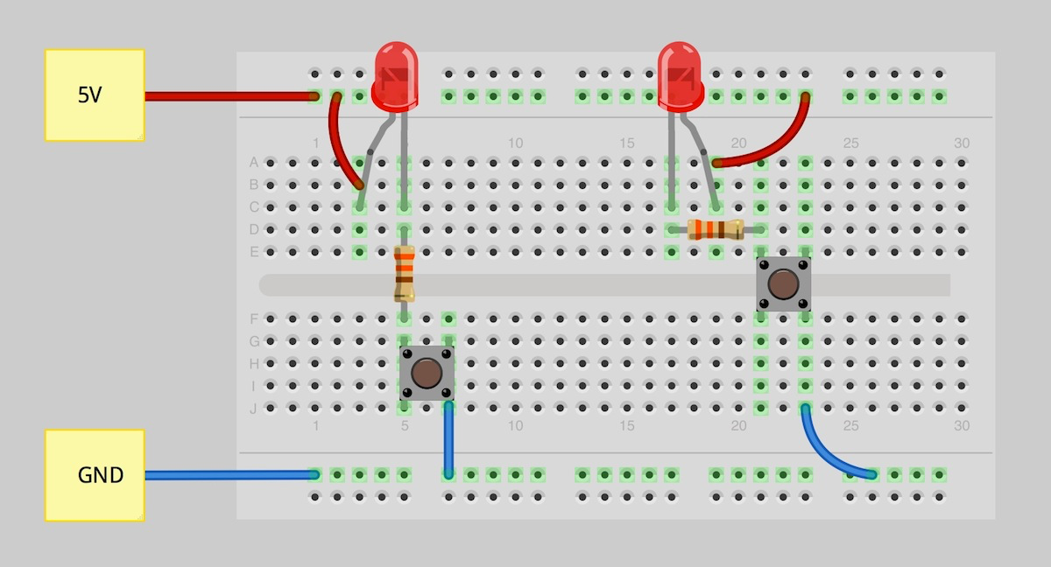
There are many ways to create your circuit on a breadboard
Image: sparkfun.com
Notes:
Theory is when you know everything, but nothing works. Practice is when everything works, but no one knows why. In our lab, theory and practice are combined: nothing works and no one knows why.

Slide 15
Kirchoff’s Law
At any node (junction) in an electrical circuit, the sum of currents flowing into that node is equal to the sum of currents flowing out of that node
Equivalently the algebraic sum of currents in a network of conductors meeting at a point is zero.
Image: Wikipedia
Notes:
Theory is when you know everything, but nothing works. Practice is when everything works, but no one knows why. In our lab, theory and practice are combined: nothing works and no one knows why.

Slide 16
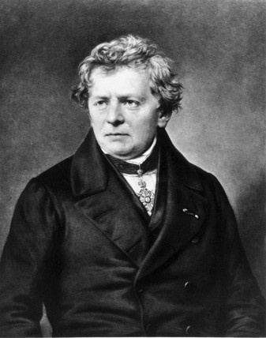
Ohm’s Law relates voltage, current, and resistance
V = I * R
Image: Sparkfun
Notes:
Theory is when you know everything, but nothing works. Practice is when everything works, but no one knows why. In our lab, theory and practice are combined: nothing works and no one knows why.

Slide 17
Ohm’s Law relates voltage, current, and resistance
Image: sengpielaudio.com

Slide 18
A note about LEDs
Current Limiting Resistor
Calculating the resistor value: https://www.sparkfun.com/tutorials/219
Image: sparkfun.com
Notes:
Theory is when you know everything, but nothing works. Practice is when everything works, but no one knows why. In our lab, theory and practice are combined: nothing works and no one knows why.

Slide 19
Let’s find the resistor we need for our LED
We can calculate the required resistance
Here’s what we need to know
i = LED forward current in Amps (found in the LED datasheet)
Vf = LED forward voltage drop in Volts (found in the LED datasheet)
Vs = supply voltage
see https://www.sparkfun.com/tutorials/219
3.8V
Vf = 3.1 V
If = 30 mA
Image: Sparkfun
Notes:
Theory is when you know everything, but nothing works. Practice is when everything works, but no one knows why. In our lab, theory and practice are combined: nothing works and no one knows why.

Slide 20
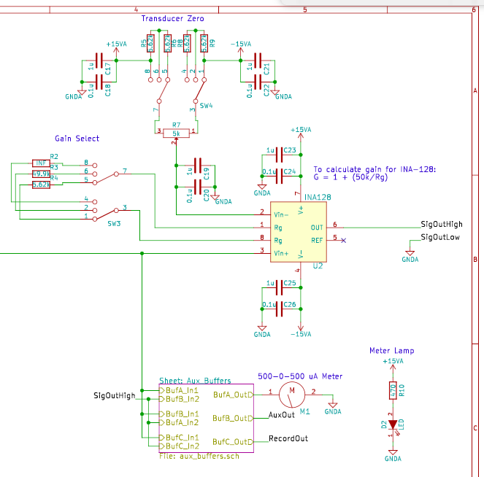
A schematic for a circuit used in the biax. Note Gain select and signal offset.
Notes:
Theory is when you know everything, but nothing works. Practice is when everything works, but no one knows why. In our lab, theory and practice are combined: nothing works and no one knows why.

Slide 21
Symbols are standardized for the basic components
Image: Sparkfun
Notes:
Theory is when you know everything, but nothing works. Practice is when everything works, but no one knows why. In our lab, theory and practice are combined: nothing works and no one knows why.

Slide 22
Junctions mark where wires are connected
Image: Sparkfun
Notes:
Theory is when you know everything, but nothing works. Practice is when everything works, but no one knows why. In our lab, theory and practice are combined: nothing works and no one knows why.

Slide 23
We also use net name labels to reduce schematic clutter
Image: Sparkfun

Slide 24
When encountering a schematic, split it up into functional blocks
Notes:
Theory is when you know everything, but nothing works. Practice is when everything works, but no one knows why. In our lab, theory and practice are combined: nothing works and no one knows why.

Slide 25
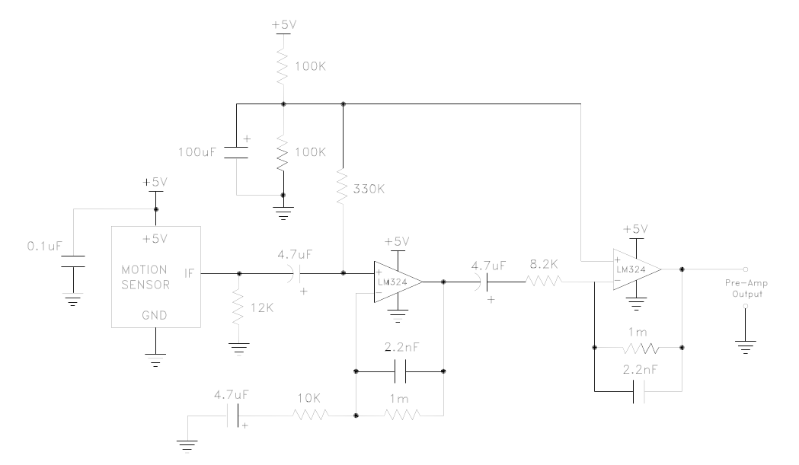
When encountering a schematic, split it up into functional blocks
Notes:
Theory is when you know everything, but nothing works. Practice is when everything works, but no one knows why. In our lab, theory and practice are combined: nothing works and no one knows why.

Slide 26
Look for voltage rails, these a great staring test points
Images: Sparkfun
Notes:
Theory is when you know everything, but nothing works. Practice is when everything works, but no one knows why. In our lab, theory and practice are combined: nothing works and no one knows why.

Slide 27
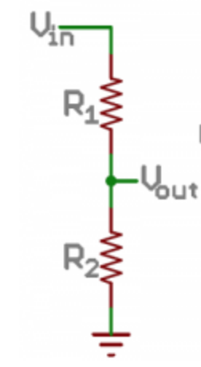
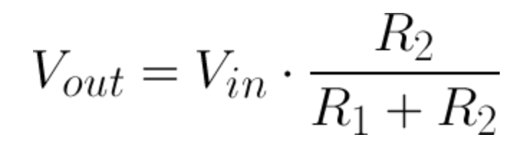
Let’s build a voltage divider
It’s a v. important basic circuit and used for many things from signal offset to A2D conversion
https://learn.sparkfun.com/tutorials/voltage-dividers/all

Slide 28
A deeper dive into the basic components
Image: Wikipedia

Slide 29
Resistors
Notes:
Theory is when you know everything, but nothing works. Practice is when everything works, but no one knows why. In our lab, theory and practice are combined: nothing works and no one knows why.

Slide 30
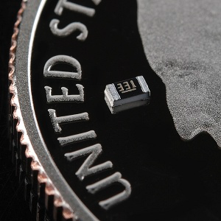
Resistors restrict the flow of electrons through a circuit
Images: Sparkfun
Notes:
Theory is when you know everything, but nothing works. Practice is when everything works, but no one knows why. In our lab, theory and practice are combined: nothing works and no one knows why.

Slide 31
Resistors in series are added together
Image: Sparkfun
Notes:
Theory is when you know everything, but nothing works. Practice is when everything works, but no one knows why. In our lab, theory and practice are combined: nothing works and no one knows why.

Slide 32
Resistors in parallel are the inverse sum of the inverse resistances
Image: Sparkfun
Notes:
Theory is when you know everything, but nothing works. Practice is when everything works, but no one knows why. In our lab, theory and practice are combined: nothing works and no one knows why.

Slide 33
Let’s workout an example simple resistor network
Image: Sparkfun
Notes:
Theory is when you know everything, but nothing works. Practice is when everything works, but no one knows why. In our lab, theory and practice are combined: nothing works and no one knows why.

Slide 34
Let’s workout an example simple resistor network
Image: Sparkfun
Notes:
Theory is when you know everything, but nothing works. Practice is when everything works, but no one knows why. In our lab, theory and practice are combined: nothing works and no one knows why.

Slide 35
Let’s workout an example simple resistor network
Image: Sparkfun
Notes:
Theory is when you know everything, but nothing works. Practice is when everything works, but no one knows why. In our lab, theory and practice are combined: nothing works and no one knows why.

Slide 36
Derive the equation for the voltage out of this divider
Image: Sparkfun
Notes:
Theory is when you know everything, but nothing works. Practice is when everything works, but no one knows why. In our lab, theory and practice are combined: nothing works and no one knows why.

Slide 37
Capacitors
Notes:
Theory is when you know everything, but nothing works. Practice is when everything works, but no one knows why. In our lab, theory and practice are combined: nothing works and no one knows why.

Slide 38
Capacitors can store energy in a circuit and resist voltage changes
Image: Sparkfun
Notes:
Theory is when you know everything, but nothing works. Practice is when everything works, but no one knows why. In our lab, theory and practice are combined: nothing works and no one knows why.

Slide 39
Caps in parallel are added together
Image: Sparkfun
Notes:
Theory is when you know everything, but nothing works. Practice is when everything works, but no one knows why. In our lab, theory and practice are combined: nothing works and no one knows why.

Slide 40
Caps in series go as the inverse sum
Image: Sparkfun
Notes:
Theory is when you know everything, but nothing works. Practice is when everything works, but no one knows why. In our lab, theory and practice are combined: nothing works and no one knows why.

Slide 41
Inductors
Notes:
Theory is when you know everything, but nothing works. Practice is when everything works, but no one knows why. In our lab, theory and practice are combined: nothing works and no one knows why.

Slide 42
Inductors are coils of wire, generally on a ferrous core that store energy in a magnetic field. They resist changes in current
Image: embeddedmicro.com
Notes:
Theory is when you know everything, but nothing works. Practice is when everything works, but no one knows why. In our lab, theory and practice are combined: nothing works and no one knows why.

Slide 43
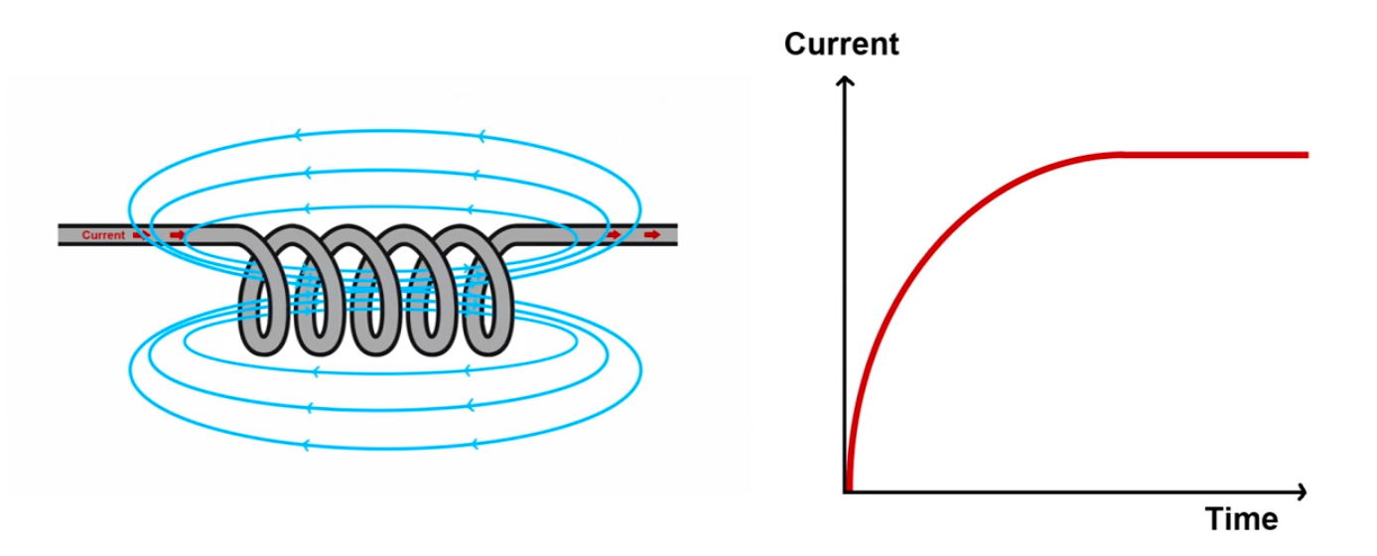
When power is applied a magnetic field is built up
Image: afrotechmods
Notes:
Theory is when you know everything, but nothing works. Practice is when everything works, but no one knows why. In our lab, theory and practice are combined: nothing works and no one knows why.

Slide 44
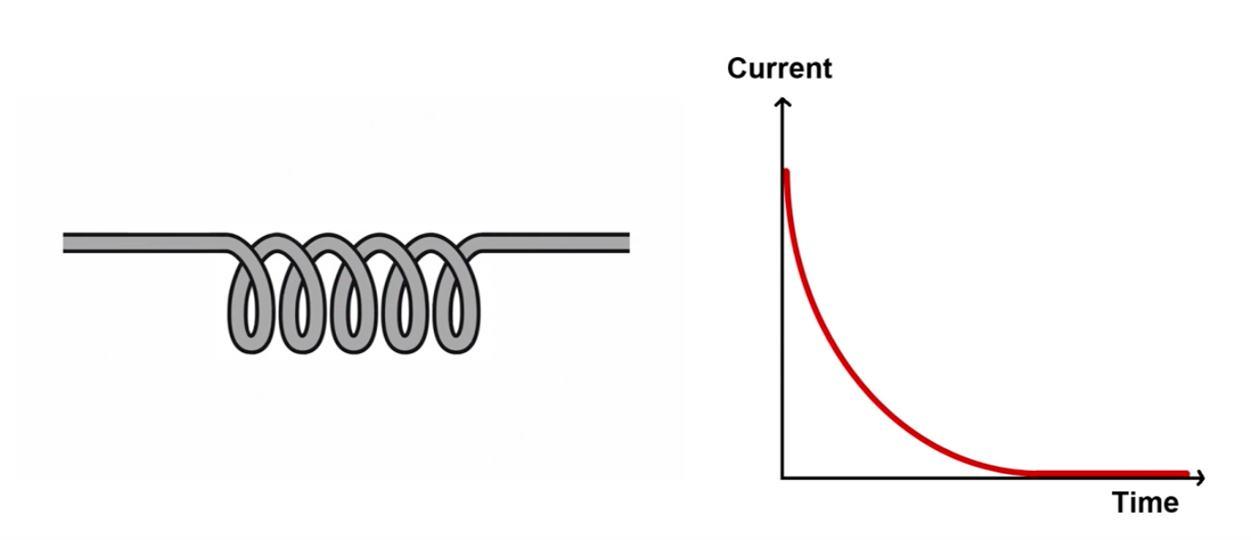
When power is removed that magnetic field dumps its energy
Image: afrotechmods
Notes:
Theory is when you know everything, but nothing works. Practice is when everything works, but no one knows why. In our lab, theory and practice are combined: nothing works and no one knows why.

Slide 45
Inductors are the basis for transformers as well
Image: electronics-tutorials.ws, Wikipedia
Notes:
Theory is when you know everything, but nothing works. Practice is when everything works, but no one knows why. In our lab, theory and practice are combined: nothing works and no one knows why.

Slide 46
Diodes
Notes:
Theory is when you know everything, but nothing works. Practice is when everything works, but no one knows why. In our lab, theory and practice are combined: nothing works and no one knows why.

Slide 47
Diodes are like the one-way valve of electronics (ideally)
Image: Sparkfun
Notes:
Theory is when you know everything, but nothing works. Practice is when everything works, but no one knows why. In our lab, theory and practice are combined: nothing works and no one knows why.

Slide 48
Current can from from the anode to the cathode, but not from the cathode to the anode
Image: Sparkfun
Notes:
Theory is when you know everything, but nothing works. Practice is when everything works, but no one knows why. In our lab, theory and practice are combined: nothing works and no one knows why.

Slide 49
Here are two simple equivalent circuits
Image: Sparkfun
Notes:
Theory is when you know everything, but nothing works. Practice is when everything works, but no one knows why. In our lab, theory and practice are combined: nothing works and no one knows why.

Slide 50
There are also optical diodes (light emitting and current generating)
Image: Sparkfun
Notes:
Theory is when you know everything, but nothing works. Practice is when everything works, but no one knows why. In our lab, theory and practice are combined: nothing works and no one knows why.

Slide 51
Transistors
Notes:
Theory is when you know everything, but nothing works. Practice is when everything works, but no one knows why. In our lab, theory and practice are combined: nothing works and no one knows why.

Slide 52
Transistors can be used as switches, controls or amplifiers
Image: Sparkfun
Notes:
Theory is when you know everything, but nothing works. Practice is when everything works, but no one knows why. In our lab, theory and practice are combined: nothing works and no one knows why.

Slide 53
Transistors are non-linear devices and operate in one of four quadrants of behavior
Image: Sparkfun
Notes:
Theory is when you know everything, but nothing works. Practice is when everything works, but no one knows why. In our lab, theory and practice are combined: nothing works and no one knows why.

